Slide 1

Theory: Raising-Awareness Essay
p. 97-100

Slide 2
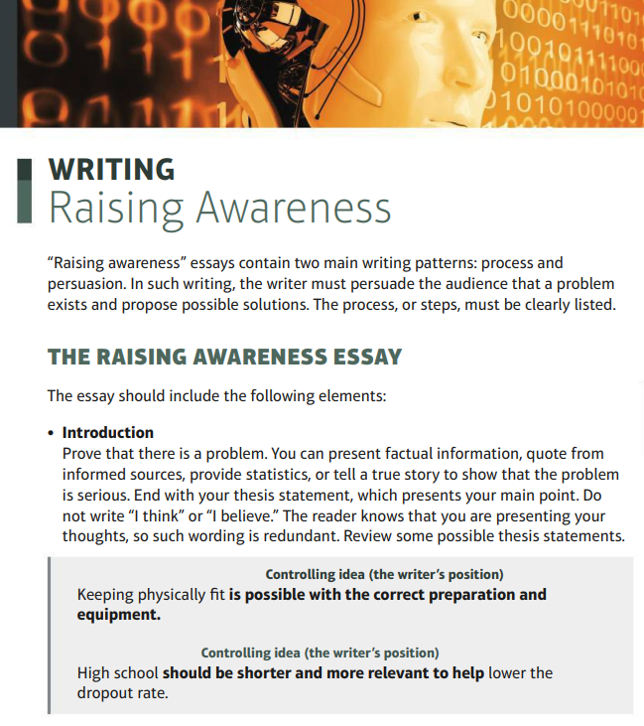


Slide 3
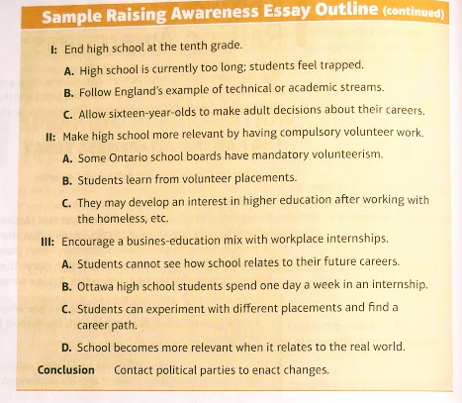
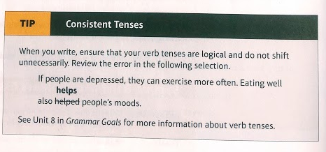


Slide 4
